Slide 1

Ad Hoc Insights for AtliQ Hardware
Aim Of The Project:-
AtliQ Hardwares is one of the leading computer hardware producers in India and well expanded in other countries too.
However, the management noticed that they do not get enough insights to make quick and smart data-informed decisions.
They want to expand their data analytics team by adding several junior data analysts. Tony Sharma, their data analytics director wanted to hire someone who is good at both tech and soft skills.
Hence, he decided to conduct a SQL challenge which will help him understand both the skills.

Slide 2
Task:-
1. Check ‘ad-hoc-requests.pdf’ - there are 10 ad hoc requests for which the business needs insights.
2. We need to run a SQL query to answer these requests.
3. The target audience of this dashboard is top-level management - hence you need to create a presentation to show the insights.

Slide 3
Tables Used:-
1.dim_customer
2.dim_product
3.fact_gross_price
4.fact_invoice_pre_deductions
5.fact_sales_monthly

Slide 4
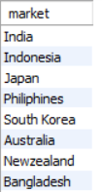
Requests:-
Provide the list of markets in which customer "Atliq Exclusive" operates its business in the APAC region.

Slide 5

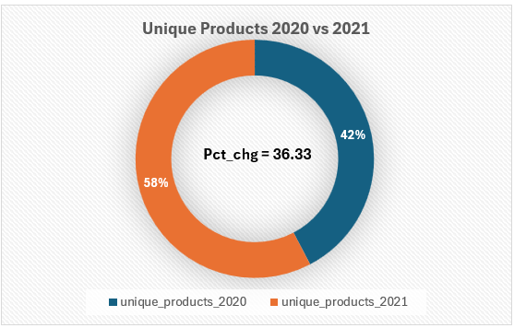
2. What is the percentage of unique product increase in 2021 vs. 2020? The final output contains these fields, unique_products_2020 unique_products_2021 percentage_chg
Insights:-
There is 36.33 percent change of unique products from fiscal year 2020 to 2021.

Slide 6
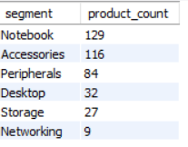
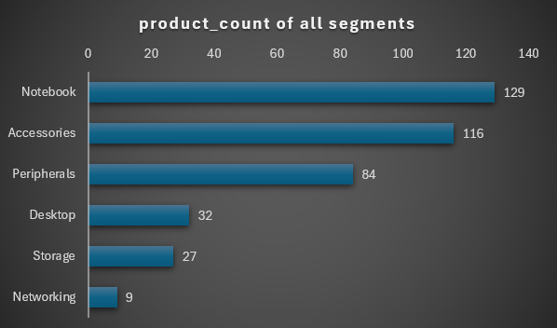
3. Provide a report with all the unique product counts for each segment and sort them in descending order of product counts. The final output contains 2 fields, segment product_count
Insights:-
We have 6 segments in AtliQ with Notebook segment having more unique products and Networking segment havling the least unique products.

Slide 7
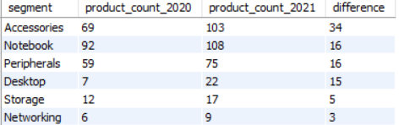
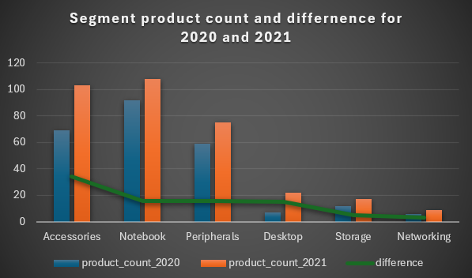
4.Which segment had the most increase in unique products in 2021 vs 2020? The final output contains these fields, segment product_count_2020 product_count_2021 difference
Insights:-
Accessories segment had the most increase in unique products from 2020 to 2021.
Storage and Networking segments didn’t has any significant change in production of new products

Slide 8
5. Get the products that have the highest and lowest manufacturing costs. The final output should contain these fields, product_code,product, manufacturing_cost
Insights:-
The products having the :-
Highest manufacturing_cost is AQ HOME Mllin 1 Gen 2 with 240.5364 as the manufacturing cost
Lowest manufacturing_cost is AQ Master wired x1 Ms with 0.8920 as the manufacturing cost.

Slide 9
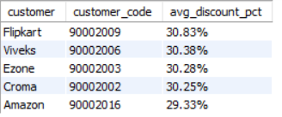
6. Generate a report which contains the top 5 customers who received an average high pre_invoice_discount_pct for the fiscal year 2021 and in the Indian market. The final output contains these fields, customer_code customer average_discount_percentage
Insights:-
The top 5 customers in India with highest average discount percentage in 2021 are:-
Flipkart
Viveks
Ezone
Croma
Amazon

Slide 10
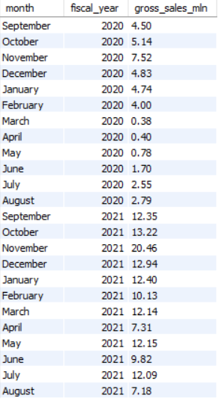
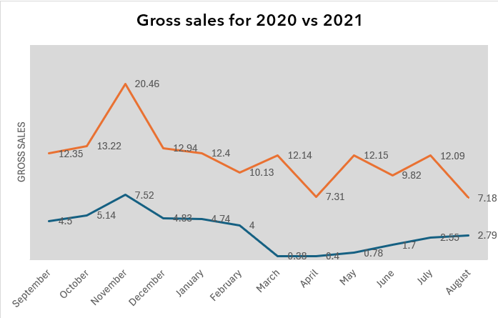
7.Get the complete report of the Gross sales amount for the customer “Atliq Exclusive” for each month. This analysis helps to get an idea of low and high-performing months and take strategic decisions. The final report contains these columns: Month Year Gross sales Amount

Slide 11
Insights:-
Highest Sales:-
In both fiscal years 2020 and 2021, we have highest sales in September month and
Lowest Sales:-
2020:-
Lowest sales in March and April
2021:-
Lowest sales in April and August

Slide 12
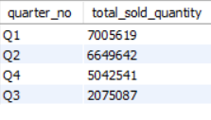
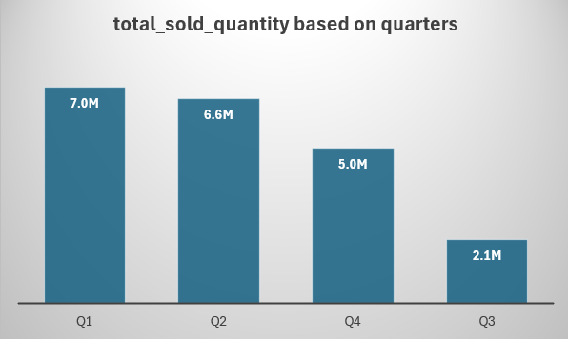
8. In which quarter of 2020, got the maximum total_sold_quantity? The final output contains these fields sorted by the total_sold_quantity, Quarter total_sold_quantity
Insights:-
In Q1 we have the highest total sold quantity and Q4 having the least sold quantity

Slide 13

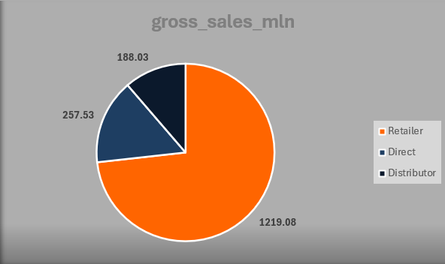
9. Which channel helped to bring more gross sales in the fiscal year 2021 and the percentage of contribution? The final output contains these fields, channel gross_sales_mln percentage
Insights:-
Retailer Channel has the highest percentage contribution in bringing more gross sales in fiscal year 2021.

Slide 14
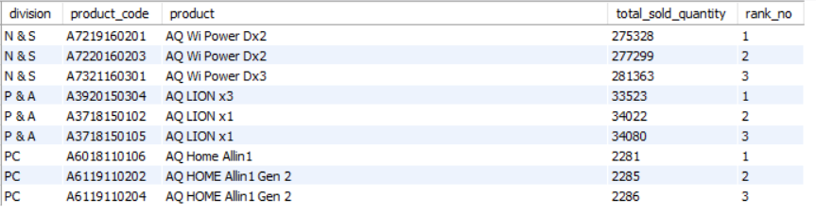
10. Get the Top 3 products in each division that have a high total_sold_quantity in the fiscal_year 2021? The final output contains these fields division, product_code, product, total_sold_quantity, rank_order

Slide 15
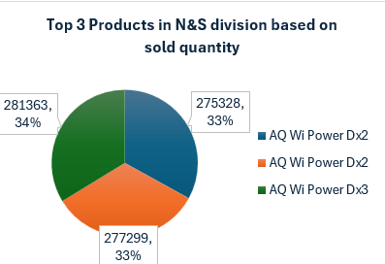
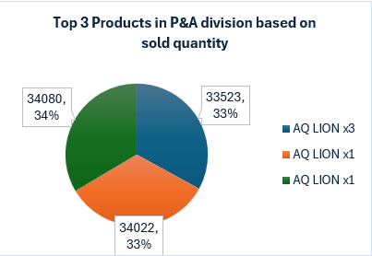
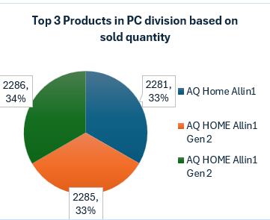
N & S Division:-
P & A Division:-
PC Division:-

